Slide 1


Graphing
Where do I find MATLAB? Here!
Do I have to have MATLAB installed on my computer right now? No, you can use MATLAB Online!

Slide 2

Table of Contents
What we've covered this week in Part 1 Programmatic Plotting Plot Options Customizing Plot Properties Specifying Colour Axis Control Plotting Multiple Columns Plotting Matrix Columns Visualizing Matrices Extra Learning Customized Annotations Creating Arrays of Strings Annotating Plots Adding Plots Adding Plot Legend What we've covered this week in Part 2
MATLAB Live Script

Slide 3
What we've covered this week in Part 1
This week in Part 1 we learnt about:
Interactively plotting data
Interactively controlling the plot view
Property inspector
Interactively formatting plots
Interactively exporting to another application

Slide 4
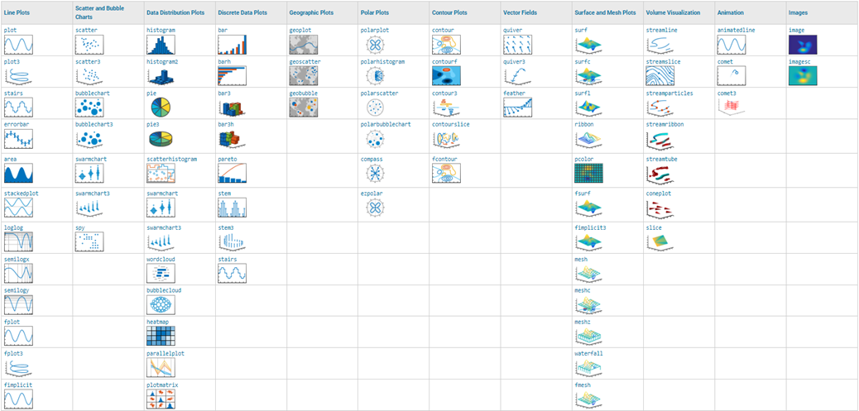
Programmatic Plotting
We now move to using commands to plot our data, rather than doing everything through the graphical interface. MATLAB offers a large variety of built-in functions to create several standard chart types.

Slide 5
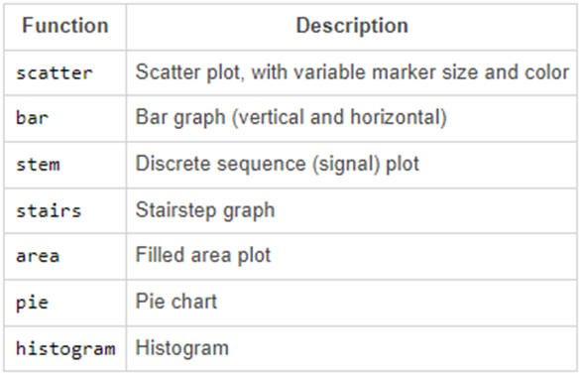
Creating and Calling Functions
See the complete list of all available plots here

Slide 6
Creating and Calling Functions
Let’s see an example making use of MATLAB’s plotting function.
Previously we plotted interactively, now let’s plot the Mexico data against Year programmatically using a linear plot:
load AuDeMx.mat
plot(Year, Mexico)

Slide 7

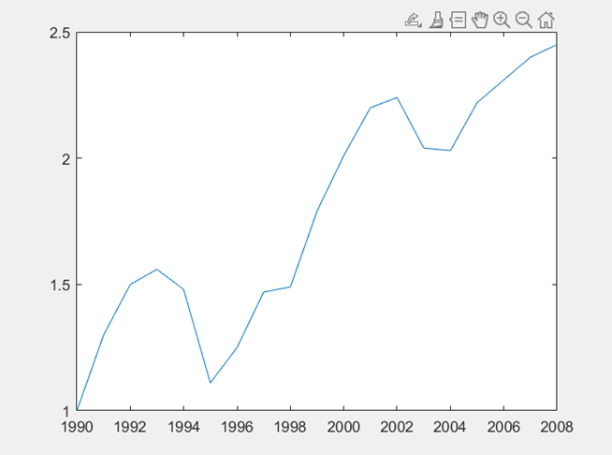
Creating and Calling Functions
Let’s see an example making use of MATLAB’s plotting function.
Previously we plotted interactively, now let’s plot the Mexico data against Year programmatically using a linear plot:
load AuDeMx.mat
plot(Year, Mexico)

Slide 8

Creating and Calling Functions
Now you try! Plot the Australia data as a function of Year:
%Plot your data here

Slide 9
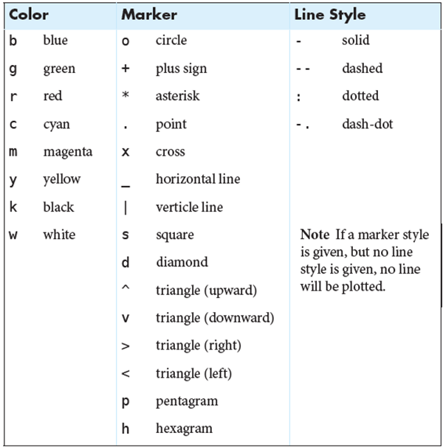
Plot Options
The plot function accepts an optional third argument that allows you to specify the basic properties of the plot’s appearance: line style, line colour, and marker style.
These options are set using a character code. This code can consist of one, two, or three characters – one for each property.

Slide 10
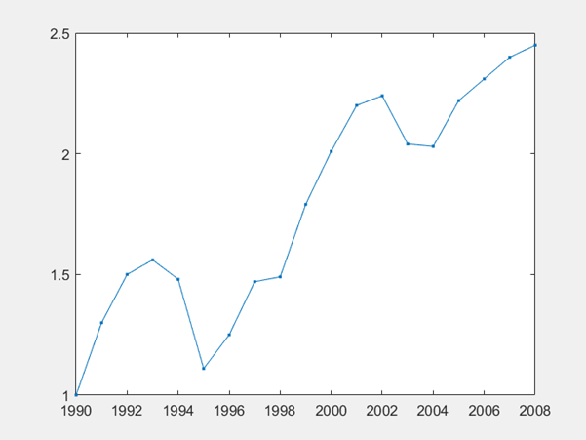
Plot Options
The characters can be combined in any order, let’s look at an exampling using these.
Let’s add a point marker and a solid line to our Mexico vs Year plot:
plot(Year, Mexico, ".-")

Slide 11
Plot Options
Now you try! Add a circle marker and a dashed line to your Australia vs Year plot:
%Plot data using a circle marker and a dashed line here

Slide 12
Customizing Plot Properties
Many properties of plot elements can be specified directly using optional pairs of inputs to the plot function (and other similar plotting functions):
plot(x,y,Property1,Value1, ...
Property2,Value2,Property3,Value3,...)
The properties are given as text, such as "LineWidth".
The accompanying value can either be a string or a numeric value, depending on the details of the property.
You can set multiple properties at once by providing multiple pairs of property names and values.
The properties can be given in any order.
A property must be immediately followed by its value.
The name-value pairs appear at the end of the argument list.

Slide 13
Customizing Plot Properties
Other than the properties that can be changed with line specification input (marker, line style, and line colour), the most commonly modified properties for a line plot are:
LineWidth (width of the line and marker edges)
MarkerSize (size of the marker symbols)
MarkerEdgeColor (color of the edge of the marker symbols)
MarkerFaceColor (color of the interior of the marker symbols)
Different graphical objects, including different plot types, have different sets of properties. Rather than try to remember the vast number of property names for each of the various types of graphical objects, you can access detailed documentation on MATLAB Graphics Objects Properties.

Slide 14
Specifying Colour
For eight specific colours, you can refer to them by name or a single letter abbreviation using the character code specified in the table under the Plot Options section.
In addition to this, you can specify over ten million other colours with a 3-element vector of red-green-blue (RGB) values. The three elements correspond to the fractional red, green, and blue parts of the colour composition. The values in this RGB range from 0 to 1.
Note that you cannot use an RGB triplet in the line specification input. Instead, to specify line colour with an RGB vector, you need to provide an optional property name-value pair to the plot function. The property name is "Color" and the corresponding value is the RGB triplet.

Slide 15
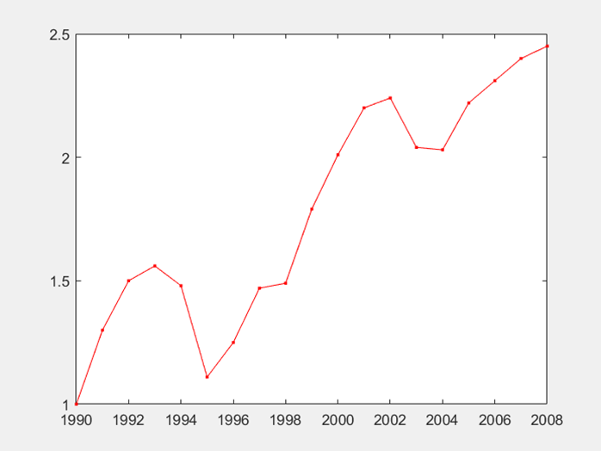
Specifying Colour
Let’s plot the Mexico data again, this time we’ll make it red using the single letter abbreviation character code as well as the RGB vector:
%Using character code
plot(Year, Mexico, "r.-")
%Using RGB vector
plot(Year, Mexico, "Color", [1 0 0],"LineStyle", "-", "Marker", ".")

Slide 16
Specifying Colour
Now you try! Plot the Germany data with a solid line and an asterisk marker, the colour should be green (use both character codes and the RGB vector):
%Using character code
%Using RGB vector

Slide 17
Axis Control
You can use the functions xlim and ylim to set the x- and y-axis limits. Both functions take a vector of two elements as an input.
For example, the following command sets the lower y-axis limit for the Mexico data to 1 and the upper y-axis limit to 2.45:
plot(Year, Mexico, "r.-")
xlabel("Year")
ylabel( "Price [$US/gal]")
title("Annual gasoline prices – Mexico")
ylim([1 2.45])
When you change the x- and y-axis limits, the underlying data in the axes is not modified—it's all still there. Only the way the plot is displayed is changed.

Slide 18
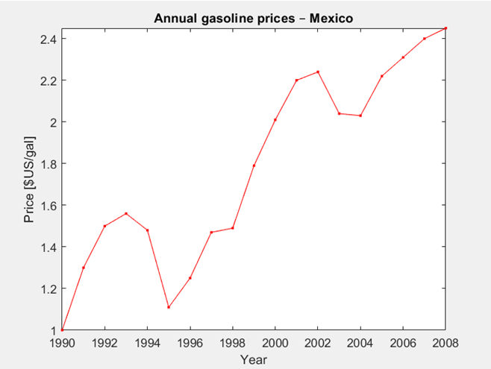
Axis Control
If you want to change the axes limits to equal exactly the range of the data, use the command:
axis tight
axis tight

Slide 19
Axis Control
Now you try! Plot the Australia data again and change the axes limits to equal exactly the range of the data:
%Plot Australia data here
%Command that changes axes limits to equal exactly the range of the data

Slide 20
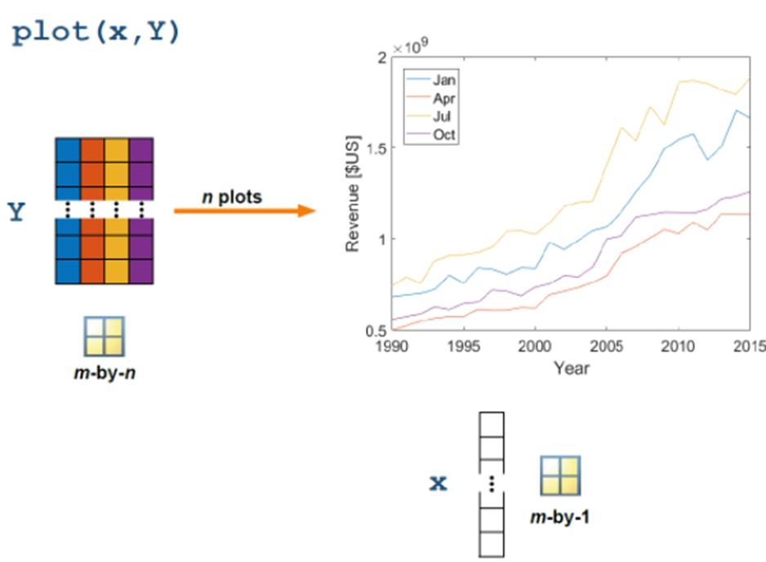
Plotting Multiple Columns
Plotting Matrix Columns
Two-dimensional plotting functions (plot, bar, stem, etc.) behave in the same manner as statistical functions when dealing with matrices: the columns are assumed to be independent variables and plotted as separate lines.
You can use the plot function on a matrix to plot each column as a separate line in your plot.

Slide 21
Plotting Multiple Columns
The file electricity.mat contains two 12-by-30 matrices, usage and price, that represent the amount of residential electricity (in MWh) sold in the U.S. and the retail price (in ¢) of a kWh of residential electricity, respectively. The 12 rows represent the 12 months of the year, and the 30 columns represent the 30 years from 1990 to 2019:
%Load the mat file
load electricity
price = price*1000/100; %Convert prices from ¢/kWh to $/MWh.
Let’s plot each year’s electricity usage simultaneously as a function of month:
plot(mth, usage)
xticks(1:12)
xticklabels(M)

Slide 22
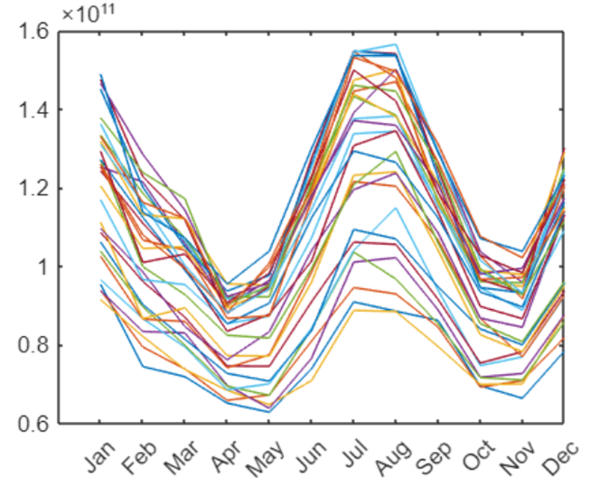
Plotting Multiple Columns
Now you try! Plot each month’s electricity usage simultaneously as a function of year (Hint: Transpose the usage matrix):
%Plot here
Does your plot look like this?

Slide 23
Visualizing Matrices
You can use the surf function to visualize an m-by-n matrix by representing each value in the matrix as the height of a surface.
surf(A)
Just like the plot function, the data is plotted against the index values if you don't specify independent variables. If you want to specify the x and y values, you can pass those as vector input to the surf function and other matrix visualization functions.
surf(X, Y, matrix)
If matrix is an m-by-n matrix, x is an n-element vector that describes the columns, and y is an m-element vector that describes the rows.

Slide 24
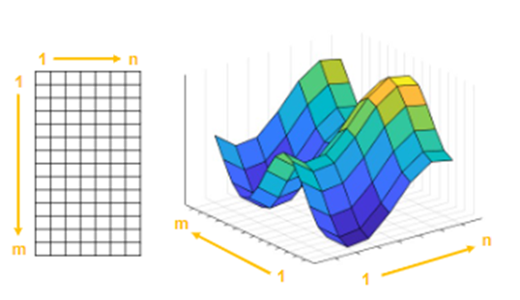
Visualizing Matrices
Let’s visualize the electricity revenue as a surface:
%First calculate the electricity revenue for all the years
revenue = price.*usage
surf(yr, mth, revenue)

Slide 25
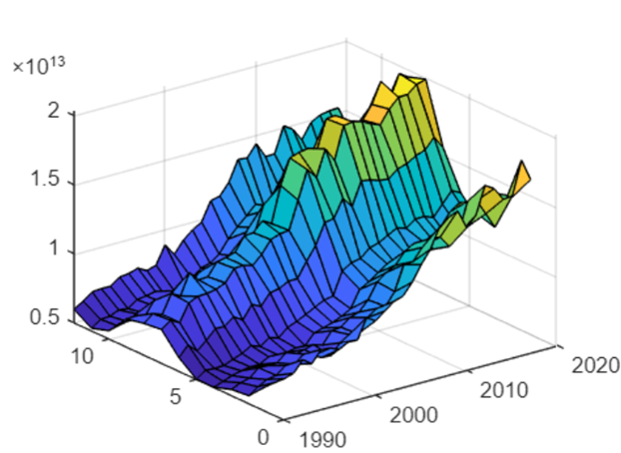
Visualizing Matrices
You can use the same syntax with the mesh function.
mesh(X, Y, matrix)
You can use a contour plot to visualize matrix data in two dimensions.
contour(X, Y, matrix)

Slide 26
Extra Learning
Customized Annotations Creating Arrays of Strings
Arrays of strings are useful for annotating visualizations. Use square brackets, [], with spaces and semicolons (;), to create a string array the same way you create a numeric matrix.
x = ["hello" "sweet";"peaceful" "world"]
x =
2×2 string array
"hello" "sweet"
"peaceful" "world"

Slide 27
Annotating Plots
Textual information can be added to plots using separate annotation functions: title, subtitle, xlabel, and ylabel. All functions take text as input. Previously we added these annotations interactively, now we can add these to a plot programmatically. Let’s look at an example illustrating this.
Let’s label our Mexico vs Year plot, the x- and y-axis as well as the title:
plot(Year, Mexico, ".-")
xlabel("Year")
ylabel( "Price [$US/gal]")
title("Annual gasoline prices – Mexico")

Slide 28
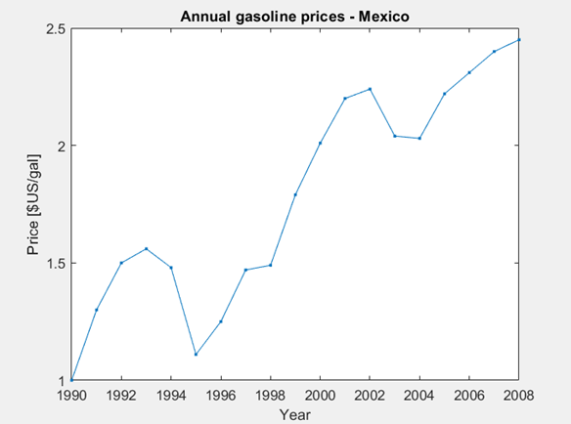
Annotating Plots
Now you try! Label the x- and y-axis as well as the title of your Australia vs Year plot:
plot(Year, Australia, "o--")
%Label your plot here

Slide 29
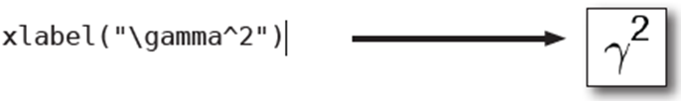
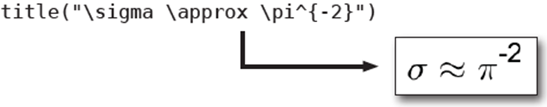
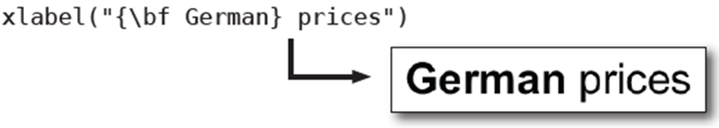
Annotating Plots
MATLAB text annotation functions use basic TeX markup interpretation. Hence, "x^2" becomes and "x_2" becomes. Use a slash (\) to display a Greek symbol in the label:
Curly braces ({}) are used as delimiters in TeX:

Slide 30
Annotating Plots
You can also display variables in labels by using them to create the string label. To add a numeric variable to a string, use the + operator.
Let’s add a subtitle to our Mexico plot:
plot(Year, Mexico, ".-")
xlabel("Year")
ylabel( "Price [$US/gal]")
title("Annual gasoline prices – Mexico")
subtitleText = "From " + Year(1) + " to " + Year(end);
subtitle(subtitleText)

Slide 31
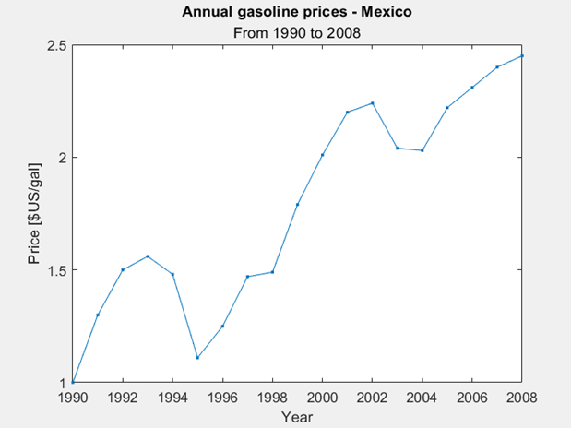
Annotating Plots

Slide 32
Adding Plots
By default, each plot command displays its own figure output. To change this behaviour, so that you can plot multiple plots on the same axes, you can issue the hold command:
hold on
All subsequent plots will be added to the current axes until the command
hold off
is issued.

Slide 33
Adding Plots
Let’s plot the Mexico and Australia data on one axis:
plot(Year, Mexico, ".-")
hold on
plot(Year, Australia, "o--")
xlabel("Year")
ylabel("Price [$US/gal]")
title("Annual gasoline prices")
hold off

Slide 34
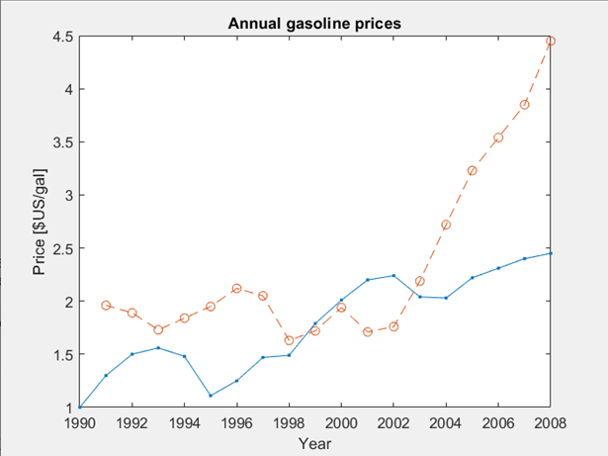
Adding Plots

Slide 35
Adding Plots
Now you try! Plot the Australia and the Germany data on one axis (the Germany plot should be a solid line with asterisk markers):
%Plot Australia data
%Command for adding additional plot on the axis
%Plot Germany data
%Label the x- and y-axis and create a title
%Last command

Slide 36
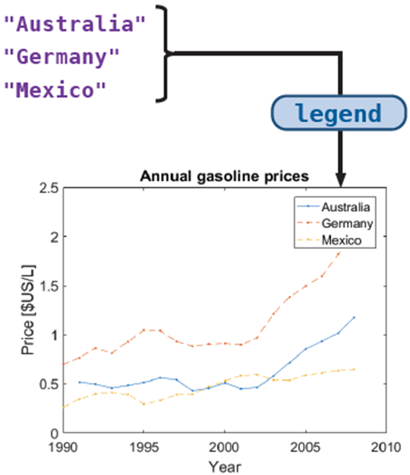
Adding Plot Legend
You can use text inputs to the legend function to identify the components of a plot with multiple elements. Each input will be identified with each plot, in order.
legend("Australia", "Germany", "Mexico")

Slide 37
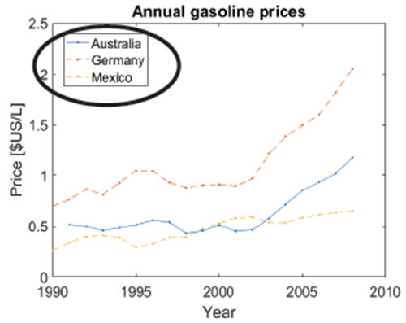
Adding Plot Legend
The legend function also accepts two optional arguments: the keyword "Location" and a text description of the location, such as "north" or "southeast":
legend("Australia", "Germany", "Mexico",... "Location", "northwest")

Slide 38
Adding Plot Legend
Now that we have two plots on one axis, we need to be able to identify which plot belongs to which set of data. We’re going to use the legend function to do this:
%Because we plotted Mexico first, that has to be our first input to the legend %function
plot(Year, Mexico, ".-")
hold on
plot(Year, Australia, "o--")
xlabel("Year")
ylabel("Price [$US/gal]")
title("Annual gasoline prices")
hold off
legend("Mexico", "Australia", "Location", "northwest")

Slide 39
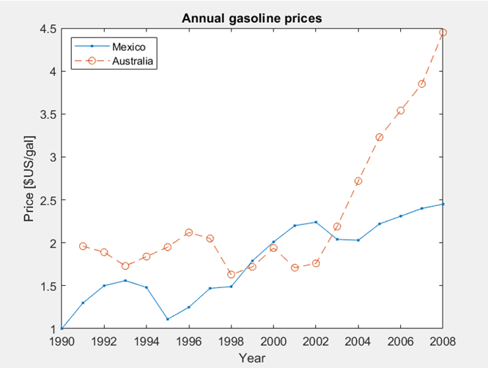
Adding Plot Legend

Slide 40
Adding Plot Legend
Now you try! Add a legend to your axis:
%Paste your previous code here
%Create a legend for your plot here

Slide 41
What we've covered this week in Part 2
This week in Part 2 we learnt about:
Programmatic plotting
Plot options
Customizing plot properties
Specifying colour
Axis control
Plotting multiple columns

Slide 42
MATLAB Live Script
Click on the link below for this lecture’s MATLAB live Script
Week_5_Part_2_Functions_and_Graphing.mlx
Copyright 2022 The MathWorks, Inc. & Opti-Num Solutions (Pty) Ltd.

